Slide 1
A Presentation
On
SOCKET PROGRAMMING

Slide 2
Agenda
- Operating system
- System calls
- Socket
- Socket API
- Client Server Program of TCP in C
- Client Server Program of UDP in C
- Sockets and Distributed Systems
Current Trends In Distributed Systems

Slide 3
Operating System
Program controlling the overall operation of a computer system and provides a set of services to system users.
  Kernel
  Application programs
  Kernel space
  User space
Current Trends In Distributed Systems

Slide 4
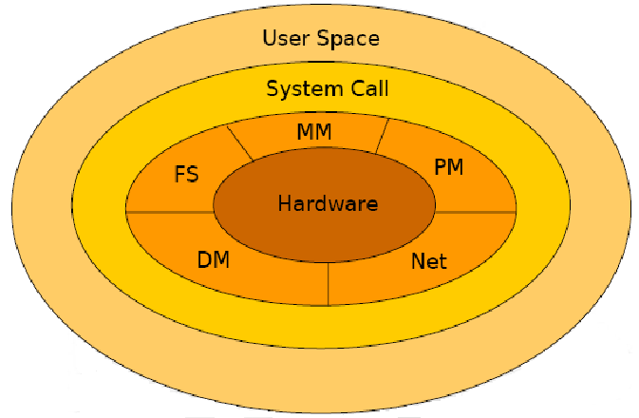
Operating System Architecture
Current Trends In Distributed Systems

Slide 5
System Call
User Space and Kernel Space are in different spaces.
- When a System Call is executed, the arguments to the call are passed from User Space to Kernel Space.
- A user process becomes a kernel process when it executes a system call.
Current Trends In Distributed Systems

Slide 6
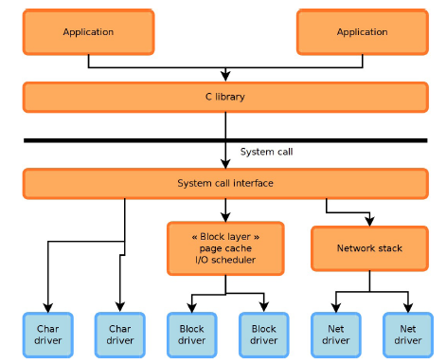
User Space and Kernel Space
Relationship
Current Trends In Distributed Systems

Slide 7
What is socket?
- Socket: An interface between an application process and transport layer
- In Linux or Unix :a socket is a file descriptor – an integer associated with an open file
- Internet sockets characterized by IP Address (4 bytes),
port number (2 bytes)
Current Trends In Distributed Systems

Slide 8
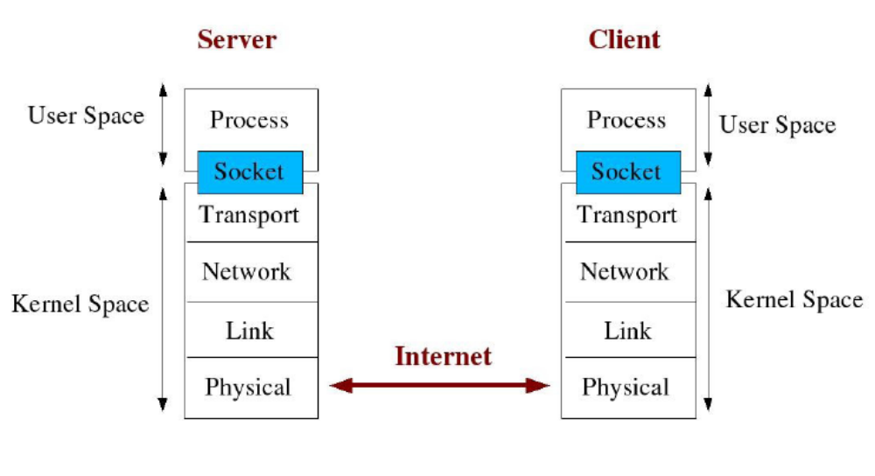
How socket works as interface?
Current Trends In Distributed Systems

Slide 9
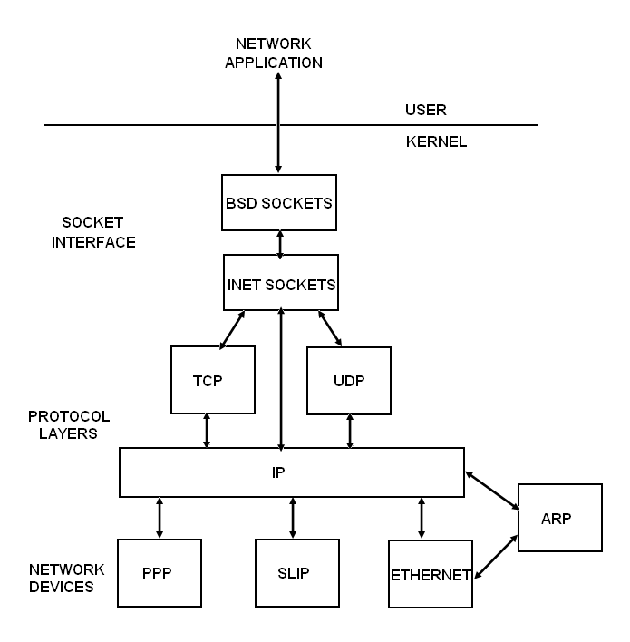
Linux Network Layers
Current Trends In Distributed Systems

Slide 10
Socket Address Families
- UNIX
- INET
- AX25
- IPX
- APPLETALK
- X25
Current Trends In Distributed Systems

Slide 11
Types of sockets
Connectionless – UDP
  - Datagram Sockets (SOCK_DGRAM)
  - Rely on UDP
  - Connection is unreliable
Connection oriented – TCP
  - Stream Sockets (SOCK_STREAM)
  - Connection oriented
  - Rely on TCP to provide reliable two-way connected communication
Current Trends In Distributed Systems

Slide 12
Internet Addressing Data Structures
struct sockaddr: Holds socket address information for many types of sockets
struct sockaddr {
unsigned short sa_family; //address family AF_xxx
unsigned short sa_data[14]; //14 bytes of protocol addr
}
/* Internet address structure */
struct in_addr {
u_long s_addr; /* 32-bit IPv4 address */
}; /* network byte ordered */
Current Trends In Distributed Systems

Slide 13
Internet Addressing Data Structures
struct sockaddr_in: A parallel structure that makes it easy to reference elements of the socket address
struct sockaddr_in {
short int sin_family; // set to AF_INET
unsigned short int sin_port; // Port number
struct in_addr sin_addr; // Internet address
unsigned char sin_zero[8]; //set to all zeros
}
Current Trends In Distributed Systems

Slide 14
Byte ordering
- Big Endian – Used in Sun Solaris, PowerPC, etc.
Lets take an example of IP address 128.2.194.95
[128][2][194][95] /* Storing array */
- Little Endian – used in i386, alpha etc.
Lets take an example of IP address 128.2.194.95
[95][194][2][128] /* Storing array */
- Network uses Big Endian Byte ordering
Current Trends In Distributed Systems

Slide 15
Byte Ordering Functions
Converts between host byte order and network byte order
‘h’ = host byte order
‘n’ = network byte order
‘l’ = long (4 bytes), converts IP addresses
‘s’= short (2 bytes), converts port numbers
htonl()- host to network byte ordering for long (4 Bytes)
htons()- host to network byte ordering for short (2 Bytes)
ntohl()- network to host byte ordering for long (4 Bytes)
ntohs()- network to host byte ordering for short (2 Bytes)
Current Trends In Distributed Systems

Slide 16
Syntax of Byte ordering functions
#include <netinet/in.h>
unsigned long int htonl(unsigned long int hostlong);
unsigned short int htons(unsigned short int hostshort);
unsigned long int ntohl(unsigned long int netlong);
unsigned short int ntohs(unsigned short int netshort);
Current Trends In Distributed Systems

Slide 17
Socket System Calls
socket()
bind()
listen()
accept()
connect()
send()
recv()
sendto()
recvfrom()
close()
Current Trends In Distributed Systems

Slide 18
1. socket()
int socket(int domain, int type, int protocol);
  – domain should be set to PF_INET or AF_INET
  – type can be SOCK_STREAM or SOCK_DGRAM
  – set protocol to 0 to have socket choose the correct
  protocol based on type
  – socket() returns a socket descriptor for use in later
  system calls or -1 on error
e.g.
  int fd; /* socket descriptor */
  if ((fd = socket(AF_INET, SOCK_STREAM, 0)) < 0) }
  perror(“socket”);
  exit(1);
  }
Current Trends In Distributed Systems

Slide 19
2. bind()
Used to associate a socket with a port on the local machine
  – The port number is used by the kernel to match an
  incoming packet to a process.
int bind(int sockfd, struct sockaddr *my_addr, int addrlen);
  – sockfd is the socket descriptor returned by socket()
  – my_addr is pointer to struct sockaddr that contains
  information about your IP address and port
  – addrlen is set to sizeof(struct sockaddr)
  – returns -1 on error
  – my_addr.sin_port = 0; //choose an unused port at random
  – my_addr.sin_addr.s_addr = INADDR_ANY; //use my IP Addr
Current Trends In Distributed Systems

Slide 20
Example of bind()
int fd; /* socket descriptor */
struct sockaddr_in srv; /* used by bind() */
/* create the socket */
srv.sin_family = AF_INET; /* use the Internet addr family */
srv.sin_port = htons(80); /* bind socket ‘fd’ to port 80*/
/* bind: a client may connect to any of my addresses */
srv.sin_addr.s_addr = htonl(INADDR_ANY);
if(bind(fd, (struct sockaddr*) &srv, sizeof(srv)) < 0) {
perror("bind"); exit(1);
}
Current Trends In Distributed Systems

Slide 21
3. listen()
Waits for incoming connections
int listen(int sockfd, int backlog);
  – sockfd is the socket file descriptor returned by
  socket()
  – backlog is the number of connections allowed on
  the incoming queue
  – listen() returns -1 on error
  – Need to call bind() before you use listen()
Current Trends In Distributed Systems

Slide 22
Example of listen()
int fd; /* socket descriptor */
struct sockaddr_in srv; /* used by bind() */
/* 1) create the socket */
/* 2) bind the socket to a port */
if(listen(fd, 5) < 0) {
perror(“listen”);
exit(1);
}
Current Trends In Distributed Systems

Slide 23
4. accept()
accept() gets the pending connection on the port you are listening on
int accept(int sockfd, void *addr, int *addrlen);
  – sockfd is the listening socket descriptor
  – information about incoming connection is stored in
  addr which is a pointer to a local struct sockaddr_in
  – addrlen is set to sizeof(struct sockaddr_in)
  – accept returns a new socket file descriptor to use
  for this accepted connection and -1 on error
Current Trends In Distributed Systems

Slide 24
Example of accept()
int fd; /* socket descriptor */
struct sockaddr_in srv; /* used by bind() */
struct sockaddr_in cli; /* used by accept() */
int newfd; /* returned by accept() */
int cli_len = sizeof(cli); /* used by accept() */
/* 1) create the socket */
/* 2) bind the socket to a port */
/* 3) listen on the socket */
newfd = accept(fd, (struct sockaddr*) &cli, &cli_len);
if(newfd < 0) {
perror("accept"); exit(1);
}
Current Trends In Distributed Systems

Slide 25
5. connect()
Connects to a remote host
int connect(int sockfd, struct sockaddr *serv_addr, int addrlen);
  - sockfd is the socket descriptor returned by socket()
  - serv_addr is pointer to struct sockaddr that contains information on destination IP address and port
  - addrlen is set to sizeof(struct sockaddr)
  - returns -1 on error
  - No need to bind(), kernel will choose a port
Current Trends In Distributed Systems

Slide 26
Example of connect()
int fd; /* socket descriptor */
struct sockaddr_in srv; /* used by connect() */
/* create the socket */
/* connect: use the Internet address family */
srv.sin_family = AF_INET;
/* connect: socket ‘fd’ to port 80 */
srv.sin_port = htons(80);
/* connect: connect to IP Address “128.2.35.50” */
srv.sin_addr.s_addr = inet_addr(“128.2.35.50”);
if(connect(fd, (struct sockaddr*) &srv, sizeof(srv)) < 0) {
perror(”connect"); exit(1);
}
Current Trends In Distributed Systems

Slide 27
6. send ()
The function is for sending stream data over stream sockets or connected datagram sockets.
int send(int sockfd, const void *msg, int len, int flags);
  - sockfd is the socket descriptor you want to send data to
  (returned by socket() or got from accept())
  - msg is a pointer to the data you want to send
  - len is the length of that data in bytes
  - set flags to 0 for now
  - sent() returns the number of bytes actually sent (may
  be less than the number you told it to send) or -1 on error
Current Trends In Distributed Systems

Slide 28
Example of send()
int fd; /* socket descriptor */
struct sockaddr_in srv; /* used by connect() */
char buf[512]; /* used by write() */
int nbytes; /* used by write() */
/* 1) create the socket */
/* 2) connect() to the server */
/* Example: A client could “send” a request to a server */
if((nbytes = send(fd, buf, sizeof(buf),0)) < 0) {
perror(“send”);
exit(1);
}
Current Trends In Distributed Systems

Slide 29
7. recv()
The function is for receiving stream data over stream sockets or connected datagram sockets.
int recv(int sockfd, void *buf, int len, int flags);
  - sockfd is the socket descriptor to read from
  - buf is the buffer to read the information into
  - len is the maximum length of the buffer
  - set flags to 0 for now
  - recv() returns the number of bytes actually read into
  the buffer or -1 on error
  - If recv() returns 0, the remote side has closed
  connection on you
Current Trends In Distributed Systems

Slide 30
Example of recv()
int fd; /* socket descriptor */
char buf[512]; /* used by recv() */
int nbytes; /* used by recv() */
/* 1) create the socket */
/* 2) bind the socket to a port */
/* 3) listen on the socket */
/* 4) accept the incoming connection */
if((nbytes = recv(newfd, buf, sizeof(buf,0))) < 0) {
perror(“recv”); exit(1);
}
Current Trends In Distributed Systems

Slide 31
8. sendto()
int sendto(int sockfd, const void *msg, int len, int flags, const struct sockaddr *to, int tolen);
  - sockfd is socket descriptor of current application socket
  - *msg is pointer to buffer
  - Int len is buffer length
  - to is a pointer to a struct sockaddr which contains the
  destination IP and port
  - tolen is sizeof(struct sockaddr)
Current Trends In Distributed Systems

Slide 32
Example of sendto()
/* Transmit data to get data from client to server */
server_length = sizeof(struct sockaddr_in);
if (sendto(fd, send_buffer, (int)strlen(send_buffer) + 1,
0, (struct sockaddr *)&server, server_length) == -1)
{
printf("Error transmitting data.");
close(fd);
exit(0);
}
Current Trends In Distributed Systems

Slide 33
9. recvfrom()
int recvfrom(int sockfd, void *buf, int len, int flags, struct sockaddr *from, int *fromlen);
  - sockfd is socket descriptor of current application socket
  - *buf is pointer to buffer
  - int len is buffer length
  - from is a pointer to a local struct sockaddr that will be
  filled with IP address and port of the originating machine
  - fromlen will contain length of address stored in from
Current Trends In Distributed Systems

Slide 34
Example of recvfrom()
client_length = (int)sizeof(struct sockaddr_in);
/* Receive bytes from client */
bytes_received = recvfrom(fd, buffer, BUFFER_SIZE, 0,
(struct sockaddr *)&client, &client_length);
if (bytes_received < 0)
{
printf("Could not receive datagram.");
close(fd);
exit(0);
}
Current Trends In Distributed Systems

Slide 35
10. close()
int close(int sockfd);
  - Closes connection corresponding to the socket descriptor and frees the socket descriptor
  - Will prevent any more sends and recvs
Current Trends In Distributed Systems

Slide 36
Connection Oriented Protocol-TCP
Server:
  1. Create socket
  2. Initialization of information
  3. Bind it with port
  4. Put socket in listen
  5. Accept connections
    5.1. Send data
    5.2. Receive data
Client:
  1. Create socket
  2. Initialization of server information
  3. Connect with server
    3.1) Send data
    3.2) Receive data
  4. close socket
Current Trends In Distributed Systems

Slide 37
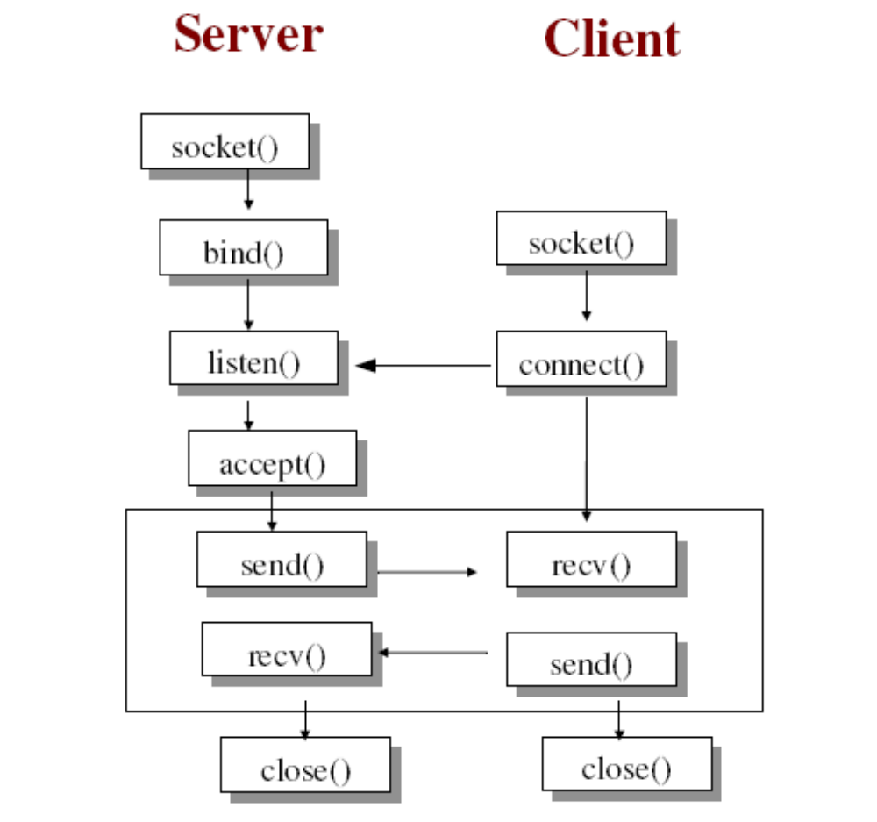
Connection Oriented Protocol-TCP
Current Trends In Distributed Systems

Slide 38
Connection less Protocol-UDP
Server:
  1. Create socket
  2. Initialization of information
  3. Bind it with port
  4. Receive from
  5. Send to
Client:
  1. Create socket
  2. Initialization of server information
  3. Send to server
  4. Receive from server
  5. Close socket
Current Trends In Distributed Systems

Slide 39
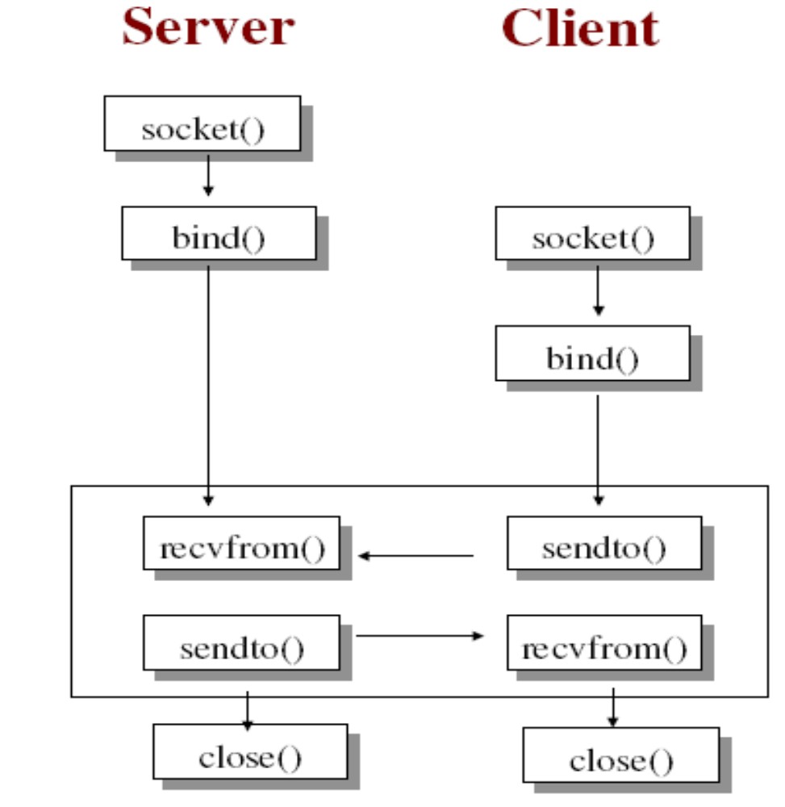
UDP- Primitives
Current Trends In Distributed Systems

Slide 40
Thank You

